Slide 1

Machine Learning Project SMS Spam Detection
By: Kiera Conway and Robert Chavez

Slide 2
Overview
Section 1 (Presented by Robert Chavez)
Project objective
Background
Machine Learning
Machine Learning in Cyber Security
Introduction To Our Study
Related Work
Dataset Introduction
Dataset Analysis
Section 2 (Presented by Kiera Conway)
Data Preprocessing
Pre-Training Setup
Model – Naïve Bayes
Model – Decision Trees
Model – K-Nearest Neighbors
Model Review
Compare Model Metrics
Conclusion

Slide 3
Project Objective
Our study aims to make a valuable contribution to the discussion on the most effective machine learning algorithm for identifying and filtering out spam messages in SMS communication.
Explore different methods of detecting spam using an open-source dataset from Kaggle and the Python programming language for preprocessing, training, testing, and analysis.
We will focus on three primary models
Naïve Bayes
Decision Trees/Random Forests
K-Nearest Neighbors (KNN)
Comparison of their performance metrics to determine the best approach for accurate classification.
Notes:
Final - Through our rigorous testing and analysis, we aim to contribute to the ongoing efforts to improve cyber security and help prevent spam messages from causing harm.

Slide 4

Background
Technology has advanced rapidly
These systems can be abused by marketers or threat actors via the use of spam or malware.
Spam is unwanted or unsolicited digital communication that gets sent out in bulk.
Threat actors leverage spam methods to send out mass emails or SMS messages
Notes:
1.With that advancement comes many benefits such as email or SMS messages.
4.Phishing attempts in an effort to obtain PII (personally identifiable information), credit information, and/or unauthorized system access using spam or malware.

Slide 5

Machine Learning - History
Machine learning (ML) is a field of computer science that dates back as early as the 1940’s.
Researchers first began exploring ways to teach computers to learn from data.
Machine Learning was created to help process these large amounts of data, many of which are too vast for humans to process efficiently.

Slide 6
Machine Learning - Strengths
Machine learning’s strength within it’s machine learning algorithms.
These algorithms allow machine learning to automatically learn from data, identify patterns, and make predictions without the need to being explicitly programmed.
When these algorithms are given large datasets to analyze, they are able to identify underlying patterns and make predictions based on new, unseen data.
Notes:
3.In other words, instead of being given specific instructions for what to do with the data, machine learning algorithms are designed to learn from patterns in the data itself.

Slide 7
Machine Learning In Cyber Security
Ability to learn and adapt to new data
Historically, rule-based systems were the primary method of detecting threats.
These methods often struggle to identify new and emerging threats
The adaptability of machine learning algorithms enables them to identify anomalies that rule-based methods fall short.
Notes:
makes machine learning particularly versatile and ideal for the constantly evolving nature of Cyber Security.
as they rely on pre-defined rule sets that can be easily exploited.

Slide 8

Machine Learning in Cyber Security - Threats
An example of ML's superiority over rule-based systems can be seen in the context of spam detection.
Spam emails and text messages are a major threat to cyber security
By leveraging machine learning we can effectively lower the attack surface
Notes:
2. have many malicious intentions, including illegally accessing confidential data such as passwords and other important identifiers, spreading malicious software with harmful links or attachments.
3. by effectively detecting spam attempts thus minimizing exposure to spam or potential phishing attempts.

Slide 9
Machine Learning in Cyber Security – Spam Identification
To minimize the amount of spam we receive in an effort to lower the attack surface or amount of spam one receives we must utilize a spam filter.
Spam filter application reviews the email or SMS message for anomalies such as misspelled words, malicious links, and other relevant threats.
To understand and compare the best methods for filtering spam messages we have selected SMS datasets in which we will leverage spam vs ham algorithms to classify our SMS messages as spam or legitimate (ham).
Notes:
Spam filter - an application or a rules-based system that identifies the difference between a spam message and a legitimate message.
If it finds any of these issues it will either flag the message as spam or alert the user to verify if the spam is indeed spam.

Slide 10

Machine Learning in Cyber Security – Spam vs Ham
Spam vs ham methods are used for detecting and preventing threats such as spam and phishing attacks.
These algorithms allows the system to adapt to new unknown types of spam
Although effective they are not perfect
Notes:
2. since it is trivial for an attacker to modify the content of the spam to circumvent the rules-based system.
3. Attackers can deliberately craft messages to evade detection by the algorithm.

Slide 11
Introduction To Our Study
Dataset
Our data set will consist of the SMS Spam collection data set which will be sourced from University Of California Irvine’s machine learning repository.
https://archive.ics.uci.edu/ml/datasets/SMS+Spam+Collection
Programming language
Python 3
Tools
Kaggle
Jupyter notebook
ML Models
K-Nearest neighbors
Naïve bayes
Decision tree/random forest
NLP/NLTK

Slide 12
Related Work
Review of the related work from [1] M. Gupta, “A Comparative Study of Spam SMS Detection Using Machine Learning Classifiers,” Aug. 2018.
Some accuracy figures for the study to note
Decision trees classifier had an accuracy rate – 96.05
Support vector machine had an accuracy rate – 98.57
Convolutional Neural Network had an accuracy rate – 99.10
Artificial Neural Network had an accuracy rate – 98.39
The results our research will allow us to better understand why other approaches may or may not offer expected results when taking accuracy and performance into consideration.
We hope to gain additional insight as to which methods are currently producing the best results while demonstrating which methods may or may not work for the intended application.
Notes:
Convolutional Neural network – Usually used for classification of image related data. Seemed to work well.
2.We decided to try a couple similar methods of detecting spam while trying other methods that are not commonly used for spam detection.
2. This was to see if other methods could offer better accuracy or performance. Just as in our related work in which they used CNN to classify spam vs ham.

Slide 13
Methods – Data Set Information
We have selected the publicly available Kaggle dataset - Spam (or) Ham
The original message collection was consolidated from various public sources.
425 spam messages from Grumbletext
3,375 ham messages from NUS SMS Corpus (NSC)
450 ham messages from Caroline Tag's PhD Thesis
1,002 ham and 322 spam messages from the SMS Spam Corpus v.0.1 Big
Each message is split between two columns: ‘Class’ which identifies whether it is spam or ham, and ‘sms’ which contains the plain-text version of the message.
Notes:
1. to train and test our spam classification models [SpamVHam].
2. This dataset is a condensed version of The University of California, Irvine’s (UCI) ‘SMS Spam Collection Dataset’

Slide 14

Methods – Data Analysis
To prepare our data for use in our ML algorithms we need to review and analyze a series of properties and decide which, if any, transformations were required.
We began by importing the comma-separated values (CSV) data file using the python library, Pandas.
Our process begins through a series of steps, including observing general information, checking for extraneous null values, viewing various observations, and analyzing statistical information.
These are important steps as they are examples of noise.
Notes:
2. Pandas is an open-source python library which is commonly used in machine learning as it helps organize, manipulate, and analyze complex tabular data.
4. Noise - which can cause overfitting and potentially “result in more complex models that miss the true pattern”

Slide 15
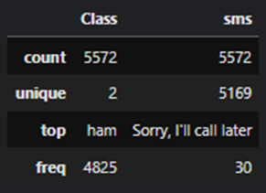
Methods – Data Analysis Continued
The statistical information in Figure 1 also shows the number of possible unique observations:
The most common value.
Frequency of the most common value.
As we can see in Figure 1, the amount of unique observations for Class are the expected value of 2 for ‘spam’ and ‘ham.’
Within the Class column, these two rows show us that most messages are categorized as `ham`, with 4825 occurrences.
Notes:
2. We use this information to determine the completeness of our data, and verify the values contained are expected and acceptable.
3. We notice sms indicates a unique value of 5169, which is less than the expected 5572; as such, we must conclude that some messages are identical
4. Shows that the most frequent message "Sorry, I'll call later,“ - Occurs 30 times
5. which leave the remaining 747 messages to be categorized as `spam`.

Slide 16
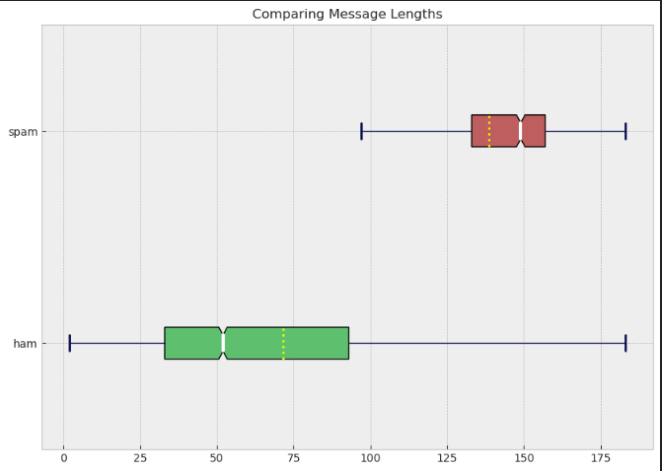
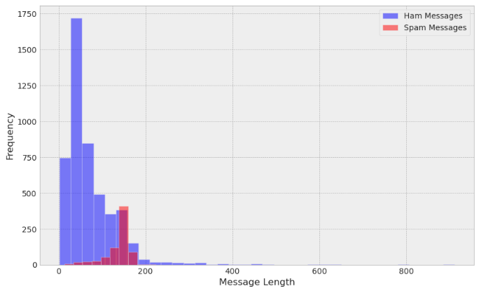
Methods – Data Preprocessing
‘Class’ Column:
Numerical Representation for Spam/Ham
‘sms’ Column:
Message Lengths
Natural Language Processing
Punctuation
Stopwords
Tokenization
Lemmatization
Case Sensitivity
Phone Numbers
(123) 456-7890
PhoneNumberID
(895) 217-7940
PhoneNumberID
Notes:
Hi my name is kiera Conway and I will be taking over for the methods part of our presentation.
As it currently stands, both of columns are in a categorical format and need to be mapped to their numerical representation.
For our class column, this was fairly simple: spam becomes 1 and ham becomes 0.
However, this process is not so simple for our sms column - Not only are there more values in this column, there are many nuances between a legitimate text and spam. So, it was to be a multi-step process.
First we tracked message length as it can be an important indicator of message type. If you look at the BW plot, entire interquartile range (IQR) of all ham messages have message lengths that fall below the minimum value for spam messages - meaning 75% of all HAM are shorter than our min spam. . Now bare in mind, this graph excludes outliers, but the point is still made, longer message lengths potential indicator of spam. So we calculated these values and saved them to a new column sms_len.
Next we handled the words in the actual messages by implementing Natural Language Processing. For this, we tokenized each message and removed punc and stopwords. We also converted each word to its root form through lemmatization. Now, while converting messages to all lowercase is common for this type of classification, we opted not to do it as Spam messages intentionally use uppercase letters to attract user attention. Also, we converted our phone numbers to a common ID to reduce the dimensionality of of the dataset while still tracking each occurrence.
------------------------------------------
removed words are called 'stop words’
Important they are removed during preprocessing to reduce noise
Since they occur “very frequently and their presence doesn't have much impact on the sense of the sentence” they can cause bias
NLTK
Corpus of a vast collection of these most frequently occurring words,
So We don’t have to manually create a list
Phone numbers
unique and do not provide additional context
Feature Engineering: Replaced them a special identifier
To keep a record of their occurrence
Prevents them from being treated as separate and unrelated features
Enables the model to identify patterns between sms that contain phone numbers more easily
reduces the number of unique features in the dataset, -> reduces the dimensionality.
Case Sensitivity
Did not convert to lowercase
While it is Common practice to convert all messages to lowercase …
[Call now example]
Final Example
New tokenized data is added to a new column ‘sms_clean’
All methods rigorously tested before implementation
‘Class’ Column:
Numerical Representation for Spam/Ham
most machine learning algorithms operate on numerical data, and cannot directly process categorical data
simple process - only two categories
Feature Extraction to new column is_spam
$LabelEncoder$ from the Python library sklearn
[show table]
Hot encoding – multiple columns for feature where column true is 1, rest are 0 (is_red, is_green, is_blue)
Label encoding - category value is mapped to an integer (red 1, green 2, blue 3)
Since only 2 values, there is no risk of "false ordinality“
order or hierarchy between the categories
categorical labels -> integers
‘sms’ Column:
Overview
More complicated due to nuances between legitimate text and spam
Message Lengths
variations between them: excessive punctuation, web addresses, phone numbers, or promotional content, etc which often result in longer, more complex messages
[show figures] Both important. BAR: Overview,
Majority Ham right under 100 characters
Majority Spam right over 150 characters
While not the point, this graph also shows how HAM dominates the dataset
B&W: more precise
Excludes Outliers
Yellow Line: average
HAM $≈$71
SPAM $≈$13
the entire interquartile range (IQR) of all ham messages in our dataset have message lengths that fall below the minimum value for spam messages, excluding outliers: meaning 75% of all HAM are shorter than our min spam
longer message lengths potential indicator of spam
While not the point, this graph also shows how HAM dominates the datase
Feature Extraction to new column sms_len
Natural Language Processing (NLP)
not all words carry significance within the context for a message
Example:
"I went to the store to buy milk."
remove "I," "to," and "the," and
still conveys original message meaning.
removed words are called 'stop words’
Important they are removed during preprocessing to reduce noise
Since they occur “very frequently and their presence doesn't have much impact on the sense of the sentence” they can cause bias
NLTK
Corpus of a vast collection of these most frequently occurring words,
So We don’t have to manually create a list
Phone numbers
unique and do not provide additional context
Feature Engineering: Replaced them a special identifier
To keep a record of their occurrence
Prevents them from being treated as separate and unrelated features
Enables the model to identify patterns between sms that contain phone numbers more easily
reduces the number of unique features in the dataset, -> reduces the dimensionality.
Punctuation
Tokenization
break down a piece of text into smaller units: tokens
Lemmatization
reduce words to their base form
Case Sensitivity
Did not convert to lowercase
While it is Common practice to convert all messages to lowercase …
Spam messages intentionally use uppercase letters to attract user attention
[Call now example]
Final Example
New tokenized data is added to a new column ‘sms_clean’
All methods rigorously tested before implementation

Slide 17
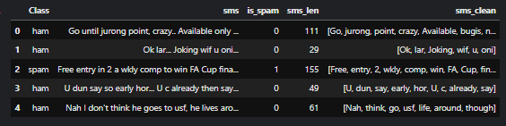
Methods – Data Preprocessing
Notes:
New tokenized data is added to a new column ‘sms_clean’
Here is a preview of a before and after we mapped our columns to their numerical representation
Natural Language Processing
Msg length is only one feature
the words used in a message are also critical for effective classification [Next Slide]
This process is fairly simple for our ‘class’ column,
‘Class’ Column:
Numerical Representation for Spam/Ham
most machine learning algorithms operate on numerical data, and cannot directly process categorical data
simple process - only two categories
Feature Extraction to new column is_spam
$LabelEncoder$ from the Python library sklearn
[show table]
Hot encoding – multiple columns for feature where column true is 1, rest are 0 (is_red, is_green, is_blue)
Label encoding - category value is mapped to an integer (red 1, green 2, blue 3)
Since only 2 values, there is no risk of "false ordinality“
order or hierarchy between the categories
categorical labels -> integers
‘sms’ Column:
Overview
More complicated due to nuances between legitimate text and spam
Message Lengths
variations between them: excessive punctuation, web addresses, phone numbers, or promotional content, etc which often result in longer, more complex messages
[show figures] Both important. BAR: Overview,
Majority Ham right under 100 characters
Majority Spam right over 150 characters
While not the point, this graph also shows how HAM dominates the dataset
B&W: more precise
Excludes Outliers
Yellow Line: average
HAM $≈$71
SPAM $≈$13
the entire interquartile range (IQR) of all ham messages in our dataset have message lengths that fall below the minimum value for spam messages, excluding outliers: meaning 75% of all HAM are shorter than our min spam
longer message lengths potential indicator of spam
While not the point, this graph also shows how HAM dominates the datase
Feature Extraction to new column sms_len
Natural Language Processing
Msg length is only one feature
the words used in a message are also critical for effective classification [Next Slide] Natural Language Processing (NLP)
not all words carry significance within the context for a message
Example:
"I went to the store to buy milk."
remove "I," "to," and "the," and
still conveys original message meaning.
removed words are called 'stop words’
Important they are removed during preprocessing to reduce noise
Since they occur “very frequently and their presence doesn't have much impact on the sense of the sentence” they can cause bias
NLTK
Corpus of a vast collection of these most frequently occurring words,
So We don’t have to manually create a list
Phone numbers
unique and do not provide additional context
Feature Engineering: Replaced them a special identifier
To keep a record of their occurrence
Prevents them from being treated as separate and unrelated features
Enables the model to identify patterns between sms that contain phone numbers more easily
reduces the number of unique features in the dataset, -> reduces the dimensionality.
Punctuation
Tokenization
break down a piece of text into smaller units: tokens
Lemmatization
reduce words to their base form
Case Sensitivity
Did not convert to lowercase
While it is Common practice to convert all messages to lowercase …
Spam messages intentionally use uppercase letters to attract user attention
[Call now example]
Final Example
New tokenized data is added to a new column ‘sms_clean’
All methods rigorously tested before implementation

Slide 18
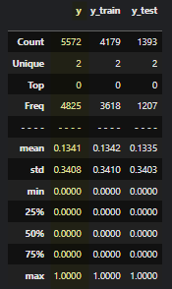
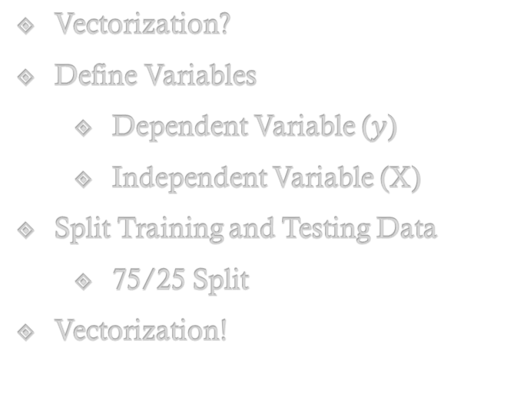
Methods – Pre-Training Setup
Vectorization?
Define Variables
Dependent Variable ($y$)
Independent Variable (X)
Split Training and Testing Data
75/25 Split
Vectorization!
 | the | quick | brown | fox | lazy | dog | jumped | over | fence
1 | 1 | 1 | 1 | 1 | 0 | 0 | 0 | 0 | 0
2 | 1 | 0 | 0 | 0 | 1 | 1 | 0 | 0 | 0
3 | 1 | 0 | 0 | 0 | 0 | 0 | 1 | 1 | 1
The quick brown fox
The lazy dog
Jumped over the fence
Notes:
Now you may have noticed our sms_clean column is not in a numerical format yet – and that’s because that mapping will take place after our train/test split as to avoid overfitting. So to handle the pre-training setup, we defined our variables and used sklearns train_test_split to execute a 75/25 split, with 75% for training and 25% for testing. You can see the data for how this was split in the table on the right, with the yellow here being our original ‘class column’
Now that our data is split, we continued on to vectorization. For this we used skleans CountVectorizer to map each token to a distinct ID. This is also known as bag-of-words (BOW) approach -> text data is represented as a "bag" of tokens.
Vectorization?
Not yet!
we must first split our training/testing data to
avoid overfitting: models can accurately predict new, unseen data. Furthermore,
if not, we could introduce bias to our model
Model would have access to information from the testing set during the training phase, which it should not have access to.
Example: If not split, Maps “free” to the number 2, associates 2 with spam – when tested, it will identify 2 easily BUT will fail on new data as ‘free’ wont always be mapped to the value 2
Define Variables
Dependent
Algorithm Goal: classify spam/ham, and classification is dependent on each message,
‘is_spam’ becomes our dependent variable, $y$
Independent
‘sms_clean’ becomes our independent variable, $X$
Split testing/training data
75% for training and 25% for testing
[Show Photo]
Yellow is the original y before split
Vectorization!
Not that our data is preprocessed and split… we can map textual data to integers

Slide 19
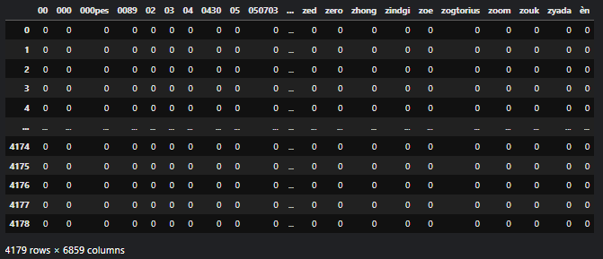
Methods – Pre-Training Setup
Vectorize the Dataset
Bag of Words (BOW) Approach
Notes:
This is a snipped of our training data after the split and vectorization . Since our dataset is very large and each unique word becomes a feature/column, countvectorizer created a very large sparse matrix
[screenshot of Training set] View Vectorizer Transformation
Our dataset is huge – each unique word becomes a feature/column
4179 rows × 6859 columns

Slide 20
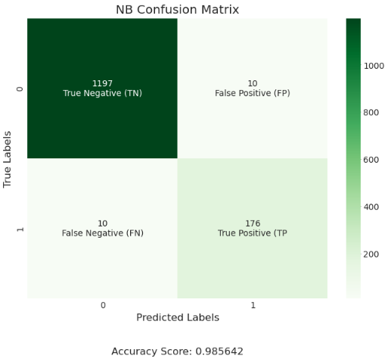
Model – Naïve Bayes
Probabilistic and Naïve
sklearn's MultinomialNB()
Notes:
Now our dataset has been preprocessed, transformed, and split into testing/training sets – we can begin training our models, We started NB which is a probabilistic and naïve algorithm. Its referred as naïve as it treats each feature as independent, which doesn’t always translate well to the real world. However, this should impact our model very much because the goal of spam classification is to identify keywords, rather than computing the complex relationship between the words.
Now as you can see, our model did quite well and got an accuracy score of 98.56% - also, if you take a look at the confusion matrix here in green, we can see that this model correctly identifies 176 instances of Spam and 1197 instances of Ham. Additionally, there were only ten instances of both FP and FN
Model Analysis:
Quite Successful - accuracy score of 98.56%.
Confusion Matrix:
correctly identifies 176 instances of Spam and 1197 instances of Ham.
(FP) 10 instances of Ham incorrectly identified as Spam,
(FN) 10 instances of Spam incorrectly identified as Ham
Now our dataset has been preprocessed, transformed, and split into testing/training sets – we can begin training our models
Probabilistic and Naïve
treats each feature as independent
Considered naïve because it doesn’t always translate well to the real world
Example: ML to test for health problem where age and blood pressure put you at higher risk
NB assumes that each feature is independent
Despite things like age/blood pressure being pos correlated (as age increases, bp increase)
However – this should not impact our model very much
Goal of spam classification -> identify keywords/phrases
Rather than capture complex relationship between the words
computes the probability of a message being spam or ham based on the presence or absence of specific words in the message.
sklearn's MultinomialNB()
specifically designed for text classification tasks like spam filtering
Model Analysis:
Quite Successful - accuracy score of 98.56%.
Confusion Matrix:
correctly identifies 176 instances of Spam and 1197 instances of Ham.
(FP) 10 instances of Ham incorrectly identified as Spam,
(FN) 10 instances of Spam incorrectly identified as Ham

Slide 21
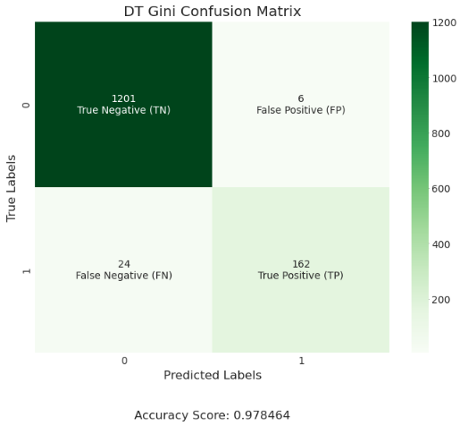
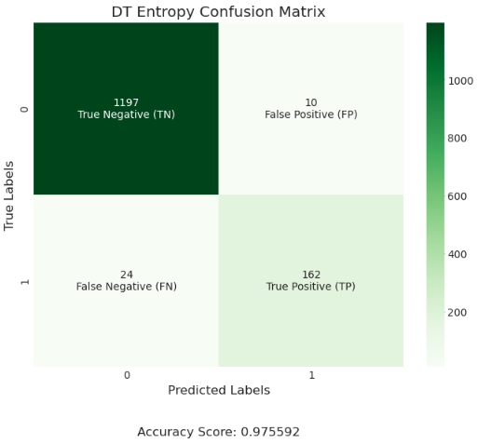


Model – Decision Trees
Hierarchical / Fixed Rules
sklearn's DecisionTreeClassifier()
Gini Impurity Model (Default)
Entropy Model
Pre-pruning Model
sklearn's RandomForestClassifier()
Random Forest Model
Notes:
Next we created and trained a couple decision tree models. These model create a hierarchical structure of fixed rules to classify data points. Essientially they are if-then statements that are built during the training phase and used to classify during the testing phase. Also note, while RF are grouped in with decision trees for sake of this presentation, they are technically not a subset of DT, but rather a method that uses DT as its base model.
Our main here was to modify the dt hyperparameters to find the best, most accurate, model. We tested DT with Gini Impurity, with entropy, with a combination of entropy and pre-pruning, and random forest. Of these, the random forest had the highest accuracy score of 97.98%, and the Gini Impurity and entropy models tied for the most TP or successful identifications of SPAM
Hierarchical / Fixed Rules
Essentially "if-then" statements
Creates a tree-like structure, hence decision trees
Continues until a leaf node is reached -> classification is made
Tree is built during training phase, used to classify during testing phase
sklearn's DecisionTreeClassifier()
Gini Impurity
Default
probability function that DT used to decide where the model should branch its 'if-then' statements
[figure 1]
lower than the accuracy score obtained by the Naive Bayes model (98.56%)
Modified hyperparameters to increase model metrics specified the entropy criterion
Entropy Model
Same goal as Gini Impurity, but Entropy ->more balanced trees, Gini -> faster computation
[figure 2]
TP: performed equal to gini (162 correct),
TN: much less accurate at (1197 correct vs 1201 correct). As such,
the accuracy score decreased to 97.55% (from 97.85)
continued Modifying hyperparameters to find model with increased accuracy without a loss in TN or TP
Pre-pruning Model
limits maximum dept/excess tree growth -> prevents overfitting
[figure 3]
Still unable to improve accuracy from gini (97.63 vs gini 97.84)
between our Entropy and Gini models at 97.63%.
TN: better than entropy (1197), same as gini (1201)
TP: less successful than both dt models (159 vs gini/entropy 162).
As the aim was to increase our overall accuracy and without sacrificing TN or TP, we attempted a random forest next.
sklearn's RandomForestClassifier()
Random Forest Model
uses multiple decision trees to make predictions
[figure 4]
Highest acc between DT -> gini 97.84% to 97.98%.
TN: highest TN
FN: with no FN
TP: important to note TP did go down
Since TN increased more than TP decreased however, acc score went up
Making RF the highest rated model
RandomForestClassifier

Slide 22
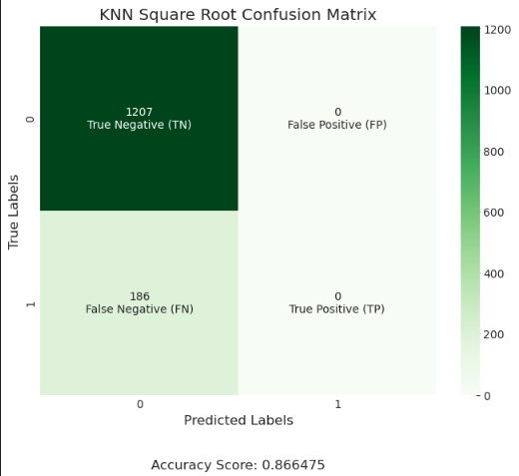
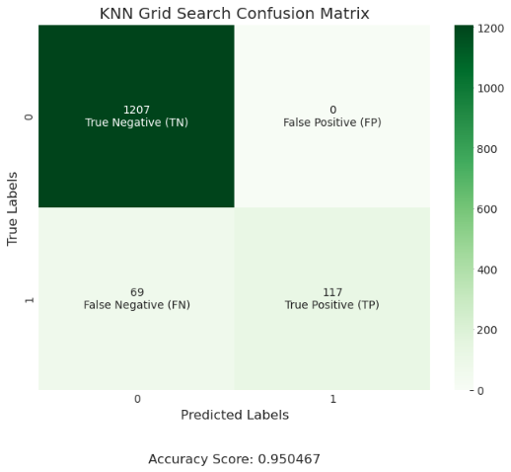
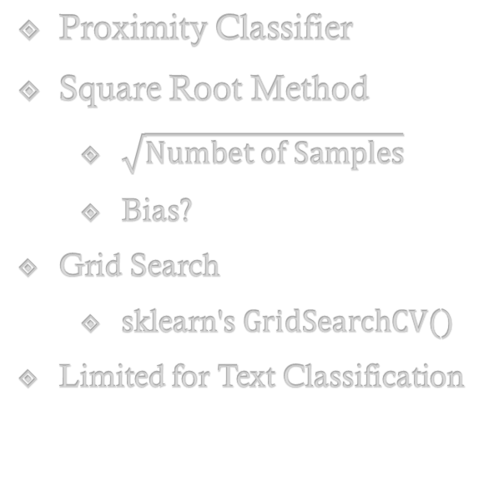
Model – K-Nearest Neighbors
Proximity Classifier
Square Root Method
$\sqrt{Numbet of Samples}$
Bias?
Grid Search
sklearn's $GridSearchCV()$
Limited for Text Classification
Notes:
Proximity Classifier
plots the features on a graph
when a new, unseen point is introduced, it determines its classification based on the class of its nearest neighbors within a region
k is the number of nearest neighbors to consider when classifying
K can be calculated multiple ways
Square Root Method
$\sqrt{Numbet of Samples}$
Sqrt of number of observations in the training set
[Figure 1]
Performed Badly -> 86.64%.
0 TP: failed to identify any instances of spam
Datset over-overwhelming number of the dataset is ham
[Figure 2]
Bias?
"class-imbalanced dataset”
the distribution of target classes is not equal
this imbalance of data w/ sqrt method -> bias towards the majority class.
the majority class will have more neighbors and therefore influence the classification more than the minority class.
Grid Search
“automated hyperparameter-tuning method”
find the optimal combination of hyperparameters (instead of having to test like we did for DT)
Does this by “$k$-fold cross-validation process”
“brute-force” through a range of parameters (nested for-loop)
finds the optimal combination for a given model
sklearn's GridSearchCV()
computationally expensive ! Set upper limit of 15 for the search space
Improved KNN accuracy score by 8.39% to 95.04%.,
TP: 117 instances of spam,
Limited
BUT! – KNN remains limited in its Spam v Ham classification abilities compared to other algorithms
high computational cost/ sensitivity to bias makes it unsuitable for large datasets with many features,
Typical for spam filtering.
computational explosions!
As the number of features increases, the distance calculation becomes more complex, reaching “exponential time [and] could lead to computational explosions”
curse of dimensionality, where the increase of features disproportionately reduces the model’s performance.

Slide 23
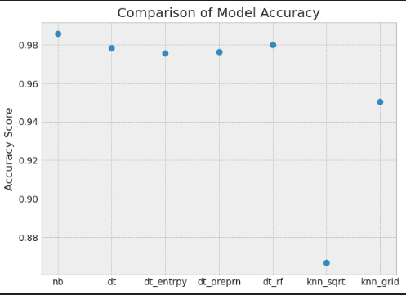
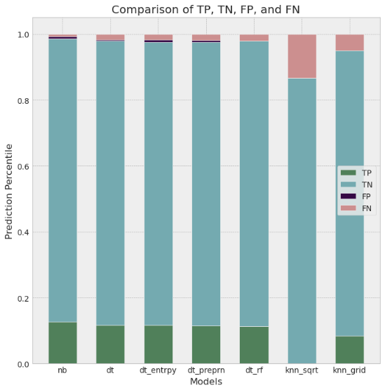
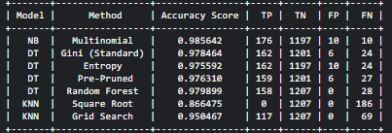
Compare Model Metrics
Notes:
Accruacy
Table
Metrics

Slide 24
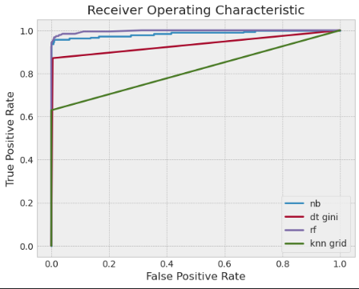
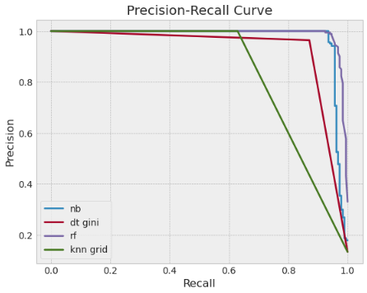




Compare Model Metrics
Recall = $\left(\frac{TP}{TP+FN}\right)$
Precision (PPV) = $\left(\frac{TP}{TP+FP}\right)$
FPR = $\left(\frac{FP}{TN+FP}\right)$
Recall (TPR) = $\left(\frac{TP}{TP+FN}\right)$
Notes:
ROC:
How well can a classifier distinguish between two classes
plotting the recall (aka TPR) against the false positive rate (FPR)
yaxis: $\text{Recall}\text{ (}\text{True} \text{Positive} \text{Rate}\text{/ }\text{Sensitivity}\text{): }$(TP/(TP + FN))
xaxis: FPR: (FP/(TN + FP)).
Area under curve (AUC) is used to dictate performance
Closer to the top-left -> better performance
PRC
Useful for heavily imbalances classes like ours
How well a model can identify positive samples while minimizing false positives
plotting the precision against the recall
Precision (Positive Predicted Value): (TP/(TP + FP))
$\text{Recall}\text{ (}\text{True} \text{Positive} \text{Rate}\text{/ }\text{Sensitivity}\text{): }\text{(}\text{TP}\text{/(}\text{TP}\text{ + }\text{FN}\text{))}$
Closer to the top-right -> better performance

Slide 25
Conclusion
Notes:
while all models have relatively high precision and recall scores, NB model is the best performer based on accuracy score,
NB model outperformed all other models with an accuracy score of 0.985642, precision of 0.9856, recall of 0.9856 and F1-score of 0.9856.
well-suited for classifying spam and ham messages
DT models performed relatively well with an accuracy score ranging between 0.975592 and 0.979899.
RF model performed even better with an accuracy score of 0.979899.
tree-based models are a good option for text-based classification
The KNN model with square root performed the worse with an accuracy score of 0.866475.
After further investigation to find the best value of K, we were able to improve slightly but KNN algorithms just aren’t the best fit for text classification

